Slide 1
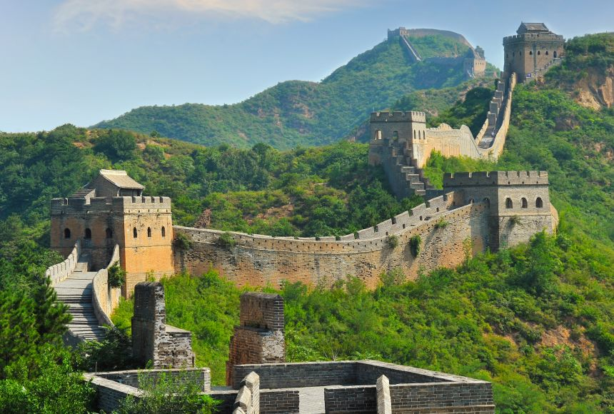
Year 3
Are we civilized?
Ancient China
RE
We deepen our understanding of the true meaning of Advent and Christmas. We also explore a number of Biblical parables and use catholic social teaching to guide us in our everyday experiences helping us to build a stronger relationship with Christ.
Maths
This term, we will cover the following topics:
• Multiplication
Division.
We continue to work on maths reasoning questions and how we can manipulate known maths facts.
Art and Design
Inspire by Ancient China, we will have fun trying calligraphy, painting, clay and modelling. We will be able to design, modify, make and evaluate our own ideas. We will also create our very own willow pattern design.
PE
This term we will exploring invasion games such as Hockey and Football. We will develop our understanding of using space when operating as part of a team, as well as improving key skills such aa dribbling, passing and shooting.
Computing
Creating media and stop frame animation. We learn how to create moving images by taking a series of still photos, moving the subject slightly between each shot, and then playing the photos back in sequence.
Music
This term, with our recorders, we create a selection of music with a deeper appreciation of musical notation. We appreciate and understand a wide range of high-quality live and recorded music drawn from different traditions and from great composers and musicians including China.
History- Ancient China
Our learning focuses on exploring the culture and history of the Shang Dynasty, a Chinese civilization that flourished along the Yellow River basin thousands of years ago. We compare our lives now and appreciate the role Ancient China played in our modern lives.
Science-. Forces and Magnets
Pupils investigate how objects move on different surfaces and explore magnetic forces. They compare contact and non-contact forces, identify magnetic materials, and observe how magnets attract or repel each other and interact with materials.
English
The Willow Pattern by Allan Drummond enables us to explore the themes of love, betrayal, and transformation, using the classic China pattern as a visual and narrative prompt.
We continue to hone our grammar skills and work hard to edit our own writing.
French
We will continue building on our language learning by moving from the greetings we have been using to meet people and enter a room, to new expressions used when leaving and at different times of the day. This progression will reinforce the children ability to politely interact and build confidence in everyday conversations.

